Slide 1
CONNECT CAREER

Slide 2
TABLE OF CONTENTS
01
04
INTRODUCTION
OBJECTIVE
02
05
OUR TEAM
METHODLOGY
03
06
SNEAK PEEK
PROBLEM STATEMENT
Technology our team will work on.
Abstract about project
Team Introduction
How we will achieve our goals.
Problem students are facing
Overview of project working.

Slide 3
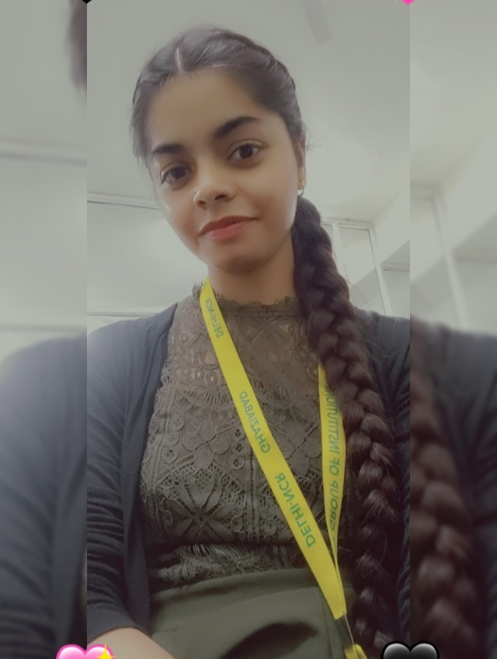
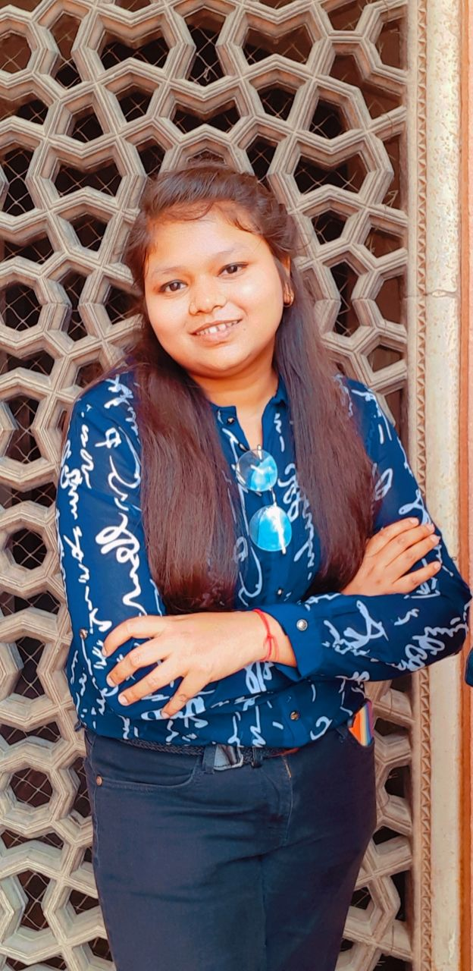
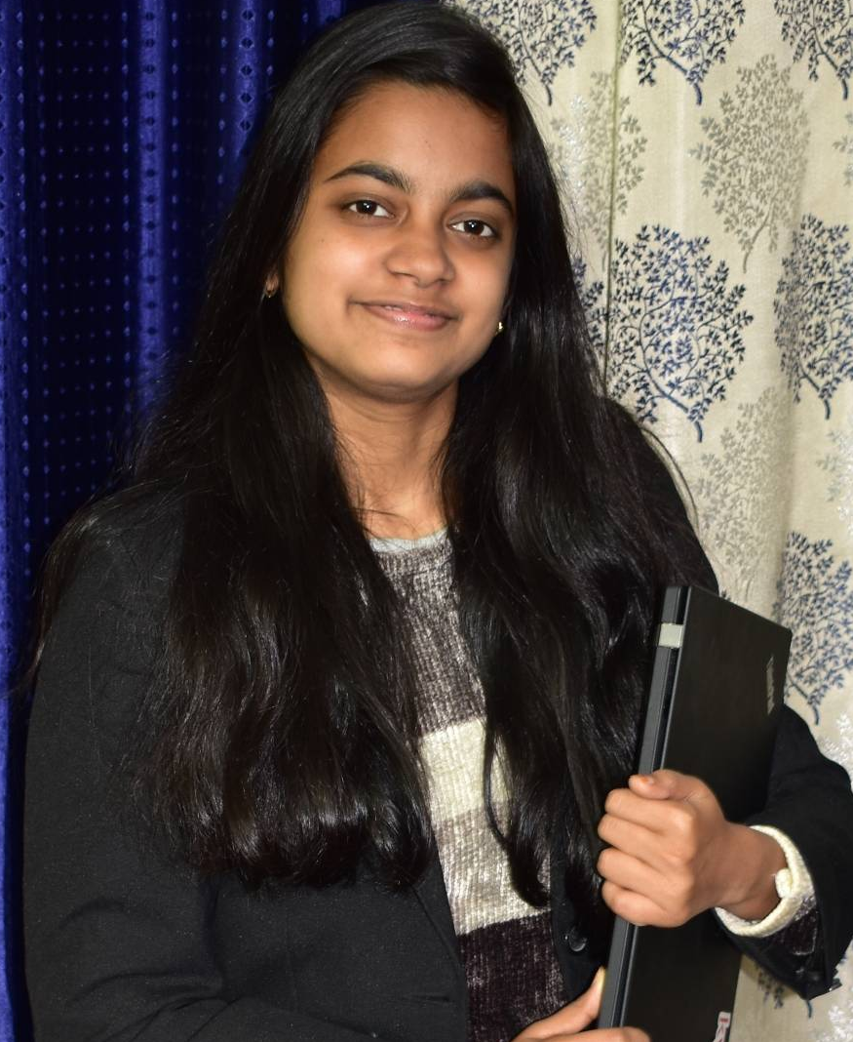
THE TEAM
NIKITA SHARMA
KASHISH GUPTA
KHUSHI VAISH
2000290120101
2000290120086
2000290120084

Slide 4
PROBLEM STATEMENT
Career Counselling is the most important thing in any student’s life. It helps him/her to select a path of life how he wants to pursue his life and earn money and have a good standard of life. Students need to explore today what they really want to do in future. They need to clarify whether they should follow the opinion of their father or mother, follow their friends or should they follow their own dream career.
But only counselling is not enough but one also need to be analyze his/her growth during the polishing of their career. It is also important to analyze the progress of the user at each and every step .
It is important to get reminders to maintain consistency of the user to excel in his/her career field.

Slide 5
ABOUT THE PROJECT
Our project includes a learning website which
would help the students to explore their interested
domain and professionals to get expertise in their
own domain through our recommended courses
and consistency analyzing feature.

Slide 6
OBJECTIVE
EXPANSION
POSITIONING
USABILITY
To provide proper guidance from choosing the career to successfully fulfilling it
To obtain a full time position in a reputed company/organization.
To maintain the consistency of the student in the path of his/her career.

Slide 7
METHODLOGY
USER INTERFACE
INTRODUCTION TO EVERY DOMAIN
FORM
DATABASE SQL(ON SUBMIT BUTTON)
RECOMMENDATION SYSTEM(ML)
AI(FOR EYE TRACKING)
REFLECTED TO DASHBOARD
SAVING DATA THROUGH SQL

Slide 8
THANKS!
Does anyone have any question?
addyouremail@freepik.com
+91 620 421 838
yourcompany.com

